Slide 1











INFORMATION, YOUNG ADULTS AND CITIZENSHIP: CHALLENGES IN THE CURRENT MEDIA ECOLOGY
Silvana Comba
Edgardo Toledo
Univ. Nac. de Rosario
Argentina

Slide 2






THIS RESEARCH SETS OUT TO ANSWER TWO KEY QUESTIONS:
How have young adults’ informative consumptions changed during the last years? And, as a consequence of this fact:
How are new media narratives changing considering the present hybrid media ecology?
Our research aims to describe and understand the practices of informative content consumption, production, and communication that young adults engage in daily within the current media ecology.
New media ecology!

Slide 3




METHODOLOGY
We have used a qualitative approach. It is an exploratory research.
We carried out 91 focus groups with university students between the ages 18 and 24 who were attending Communication and Journalism undergraduate careers in 43 Latin American universities that take part in the research project “Investigar en red.” (Network Research)
91 focus groups
43 universities

Slide 4
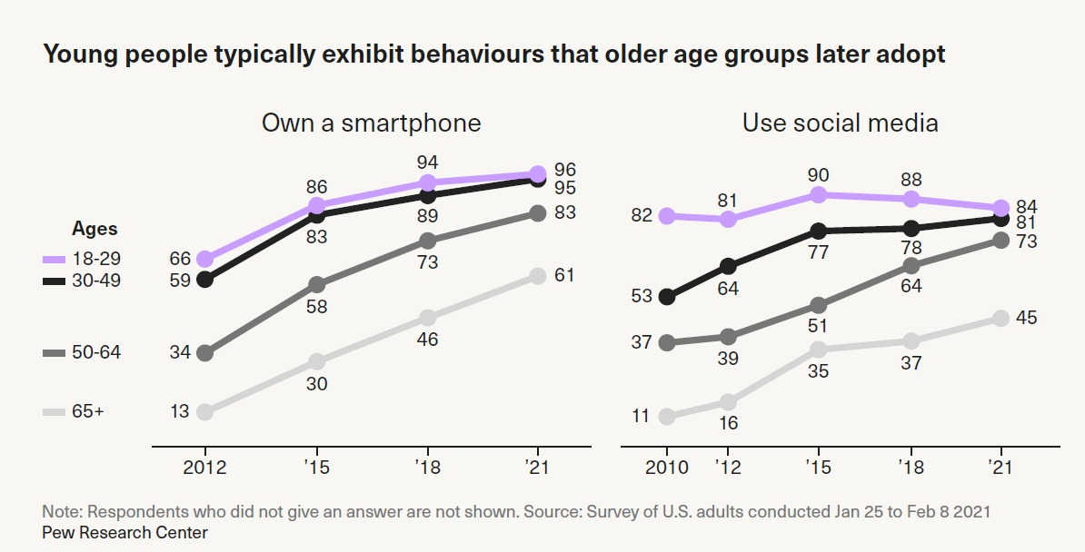
Classic devices for information consumption – TV, radio, print media – are increasingly being replaced by the paradigmatic device of our time: the smartphone.
Our research aims to describe and understand the practices of informative content consumption, production, and communication that young adults engage in daily within the current media ecology.
smartphone use

Slide 5











The smartphone serves as the gateway to incidental consumption of informative content: young adults no longer actively seek information but encounter it while scrolling through their phone screens, immersed in their networks, at any time and place.
There isn’t a unique way of consuming information. According to their needs, young adults assume different modes of consumption using a plethora of different platforms and media to engage with informative content. Each has its own role and together they create a news ecosystem.
incidental news

Slide 6



CHARACTERISTICS OF YOUNG ADULT PRACTICES OF INFORMATIVE CONTENT CONSUMPTION
-They fluidly move from one task to another one, e.g., messaging friends, buying things, playing games, catching up on gossip, and listening to podcasts while they’re on their phones, and also access to informative content (incidental consumption).
-They have honed their own sophisticated search skills on social media platforms and in online communities to avoid information overload, misinformation and disinformation. For example, using newsletters and news app notifications.
search skills
news apps

Slide 7
CHARACTERISTICS OF YOUNG ADULT PRACTICES OF INFORMATIVE CONTENT CONSUMPTION
-They fluidly move from one task to another one, e.g., messaging friends, buying things, playing games, catching up on gossip, and listening to podcasts while they’re on their phones, and also access to informative content (incidental consumption).
-They have honed their own sophisticated search skills on social media platforms and in online communities to avoid information overload, misinformation and disinformation. For example, using newsletters and news app notifications.
search skills
news apps

Slide 8






-They need simple, low-effort ways to keep up with and discover relevant news.
“Instagram has a lot of images that can catch your attention more than words. I think that is why Instagram functions so well because you get used to that format”
Vanina – 2nd year
Social Communication, UNCO, Argentina

Slide 9
CHARACTERISTICS OF YOUNG ADULT PRACTICES OF INFORMATIVE CONTENT CONSUMPTION
-They need straightforward ways to follow up on and verify news that has sparked their interest.
-They need storytelling that engages them, with an appropriate tone of voice, and appealing visual or audiovisual design.
-Traditional news brands see it as: “what you should know.” Young audiences see it as: “what you should know (to an extent), but also what is useful to know, what is interesting to know, and what is fun to know.”
new narratives
storytelling

Slide 10
CHARACTERISTICS OF YOUNG ADULT PRACTICES OF INFORMATIVE CONTENT CONSUMPTION
-They seek out sources of information from people that they know or feel like they know (e.g. their favorite influencers). This is particularly true in political campaigns where young people pay attention to interpersonal communication within their primary social groups.
-They need access to content that educates, upskills, and inspires them (when they want to dive more deeply).
- They need information that they can share that makes them feel current, connected, and socially validated.
influencers
interpersonal
communication

Slide 11

CHARACTERISTICS OF YOUNG ADULT PRACTICES OF INFORMATIVE CONTENT CONSUMPTION
“I get informed by platform with news that appears in the Instagram feed. And I also get informed by my friends who tell me what is happening.”
Agustín - 3rd year
Social Communication, UCFS, Argentina

Slide 12



Two concepts linked to how young people consume information
“I follow information related to sports, in general, and I like football very much. I watch short videos that explain tactics, show goals, or explain situations during the match. It is easier in that way. Short videos are more dynamic than reading football chronicles, though I like them too. During the time I spend reading a chronicle I can watch at least ten videos!” (Facundo, 1st year, Social Communication, Universidad Nacional de Rosario, Argentina)
Identity: informative content helps young adults construct and communicate their identity. The news they engage with contributes to defining and demonstrating who they are, and their worldview.
Entertainment: informative content, like media more widely, can be fun. Being immersed in other worlds for pleasure, feeling inspired, enjoying creativity, or simply – but no less importantly – just passing the time.

Slide 13
ALGORITHMS
Another issue that plays an important role in information consumption is the data-driven display of informative content through algorithms.
Nowadays new algorithm-free platforms are springing up to fight against automated curation.
data-driven info consumption

Slide 14
We have seen an increase in news avoidance among young adults we
interviewed.
The news, and especially certain topics (e.g. shootings in Rosario streets) and the way they are presented (especially by television) can be depressing and induce mood changes triggering sadness, fear, anger, or a sense of helplessness.
Not all informative content will have a direct impact on daily life. However, coverage of social issues, politics, and economics helps to create awareness and understanding of issues that matter to citizens and tends to increase participation in democratic processes.
News avoidance

Slide 15








Aquí puedes agregar algo que desees resaltar
“I obviously get informed, but it depends on my mood. If there is something that worries me, I prefer to take my time and continue later. News sometimes overwhelms me so I try to avoid information overload because I need time to assimilate it.” (Diego, 4th, Social Communication, UNR, Argentina).

Slide 16





TO CULTIVATE COMMUNITY
Young adults need informative content that helps them arrive at decisions that are genuinely linked to their needs and concerns and those of their communities, rather than manipulating or disempowering them.
In the present context, we need to rethink the concept of participation, which we closely link to the consumption/production of informative content.
We need to understand how young adults today exercise a connective communicational citizenship and experiment with renewed forms of politics and community living.

Slide 17


25th Annual Media Ecology Association Convention
June 6–9, 2024
Daemen University, Amherst, NY
Silvana Comba – UNR Edgardo Toledo - UNR
@8daysaweekSil @silvana-comba @panitoledo
THANKS

